Slide 1
IoT / SMART HOME ENGINEERING PROJECT
IoT-Based Home Security
and Surveillance System
Real-time intrusion, gas-leak, and fire detection with automated safety response
Reelesh Ganesh Bhoyrub
Cohort IoT 7 • Polytechnics Mauritius

Slide 2
AGENDA
What We'll Cover
01
Why Home Safety Matters
05
Wiring Walkthrough
The real-world case for automated protection
Five states, straight from the Tinkercad build
02
Evidence It Saves Lives
06
Decision Logic
Fire, gas, and burglary data
How the Arduino prioritizes hazards
03
System Components
07
Future IoT Upgrades
Sensors, actuators, and control hardware
Where this project can go next
04
System Architecture
How every part communicates
REELESH GANESH BHOYRUB | COHORT IoT 7
01

Slide 3
THE PROBLEM
Homes Fail Silently — Until It's Too Late
Fires spread, gas leaks build up, and intruders enter, all while residents are asleep, at work, or simply unaware. Traditional alarms only make noise after danger is already present. This project asks a different question: what if the home could sense the threat and act on it automatically, before a person even reaches the room?
FIRE
FIR
Rapid temperature rise from electrical or kitchen faults
GAS
GAS
Invisible leaks that build up unnoticed overnight
INT
INTRUSION
Break-ins while occupants are away or asleep
REELESH GANESH BHOYRUB | COHORT IoT 7
02

Slide 4
EVIDENCE IT SAVES LIVES · FIRE
A Working Smoke & Heat Alert
Cuts Fire Deaths in Half
According to the U.S. National Fire Protection Association, a working smoke alarm reduces the risk of dying in a reported home fire by roughly 60 percent, yet a large share of fatal fires still happen in homes where the alarm was missing or not functioning.
This project's TMP36 temperature sensor plays the same early-warning role as a heat detector: once the temperature crosses 40°C, the system doesn't just sound a buzzer — it also lights the red LED, updates the LCD, and drives Servo 3 to represent a sprinkler activating, combining detection with an automatic first response.
60%
lower risk of dying in a
home fire when a working
alarm is present
Source: National Fire Protection Association (NFPA), 2024 Smoke Alarm Report
REELESH GANESH BHOYRUB | COHORT IoT 7
03

Slide 5
EVIDENCE IT SAVES LIVES · GAS LEAKS
Carbon Monoxide Is a
Silent, Preventable Killer
Gas leaks are especially dangerous because they are colorless and odorless — occupants often have no warning at all. U.S. CDC data shows several hundred people die every year from accidental, non-fire carbon monoxide poisoning, and tens of thousands more are hospitalized, with risk peaking in winter months when homes are sealed shut.
The MQ2 gas sensor in this build continuously monitors air quality on analog pin A4. The moment a reading crosses the safety threshold, the system sounds the buzzer, displays a GAS LEAK ALERT on the LCD, and drives Servo 2 to open a window automatically — increasing ventilation before a person is even in the room to react.
400+
accidental carbon monoxide
deaths every year in the
United States alone
Source: U.S. Centers for Disease Control and Prevention (CDC), National Vital Statistics System
REELESH GANESH BHOYRUB | COHORT IoT 7
04

Slide 6
EVIDENCE IT SAVES LIVES · INTRUSION
Visible, Active Security
Changes a Burglar's Decision
A University of North Carolina at Charlotte study of 422 convicted burglars found that the large majority actively look for signs of an alarm system before attempting a break-in, and roughly 60 percent said they would abandon the attempt entirely if they discovered one active. A separate five-year Rutgers University study of Newark, New Jersey found burglary rates fell as home alarm registrations rose across the city.
This project's PIR motion sensor watches for movement while armed. On detection, it immediately locks the door via Servo 1, sounds the buzzer, lights the red LED, and displays INTRUDER DETECTED — turning passive awareness into an active, automatic response in under a second.
83%
of convicted burglars say
they check for an alarm
before breaking in
Sources: UNC Charlotte burglar survey; Rutgers University School of Criminal Justice
REELESH GANESH BHOYRUB | COHORT IoT 7
05

Slide 7
SYSTEM DESIGN
What the System Is Built to Do
1
2
3
Detect Intruders
Sense Gas Leaks
Catch Rising Heat
PIR sensor continuously watches for motion while the system is armed.
MQ2 sensor monitors air quality and flags dangerous concentrations.
TMP36 stands in for a fire/heat detector, alerting above 40°C.
4
5
6
Alert Immediately
Act Automatically
Reset On Demand
Buzzer, LEDs, and a 16×2 LCD give instant, unmistakable warnings.
Servos lock the door, open a window, or trigger a sprinkler — no human step required.
A single push-button lets the homeowner clear an alert and re-arm the system.
REELESH GANESH BHOYRUB | COHORT IoT 7
06

Slide 8
CORE COMPONENTS · PART 1
Sensing the Danger
Three sensors continuously feed real-world conditions into the Arduino Uno's analog and digital inputs.
PIR
MQ2
TMP
PIR Motion Sensor
MQ2 Gas Sensor Element
TMP36 Temperature Sensor
OUT → Digital Pin D5
Signal → Analog Pin A4
OUT → Analog Pin A5
A passive infrared sensor that detects the body heat of moving people. It watches for intrusion whenever the system is armed and reports a simple HIGH/LOW signal.
A raw 6-pin gas-sensing element (heater + resistive divider). Paired with a 10kΩ load resistor, it outputs a variable voltage that rises as gas concentration increases.
A precision analog temperature sensor. Its output voltage converts directly to °C, acting as the project's stand-in for a real fire/heat detector.
REELESH GANESH BHOYRUB | COHORT IoT 7
07

Slide 9
CORE COMPONENTS · PART 2
Taking Action Automatically
Once a hazard is confirmed, these actuators carry out the physical safety response — no human step required.
S1
S2
S3
BZ
Servo 1 — Door Lock
Servo 2 — Window
Servo 3 — Sprinkler
Buzzer + LEDs
Signal → D9
Signal → D10
Signal → D11
D4 · D2 (red) · D3 (green)
Rotates to 90° to lock the main door the instant an intruder or breach is detected, and returns to 0° in Safe Mode.
Opens to 90° during a gas leak to ventilate the room and reduce the risk of poisoning or explosion.
Simulates a water valve, turning to 90° when the fire threshold is crossed to represent suppression activating.
The buzzer tones at a different pitch per hazard; the red/green LEDs give an at-a-glance danger/safe status.
REELESH GANESH BHOYRUB | COHORT IoT 7
08

Slide 10
CORE COMPONENTS · PART 3
Control, Display & Interface
The brain of the system, plus everything the homeowner directly sees and touches.
UNO
LCD
POT
BTN
Arduino Uno
16×2 LCD Display
Potentiometer
Reset Button
Central microcontroller
RS→D12, E→D13, D4–D7→A0–A3
Wiper → LCD V0
1a → D6 (2a → GND)
Reads every sensor, runs the decision logic each loop cycle, and drives every actuator and display in the circuit.
Shows a live, human-readable status: SYSTEM SECURE, INTRUDER DETECTED, GAS LEAK ALERT, or FIRE DETECTED.
A simple contrast control that keeps the LCD text crisp and readable.
A single push-button that lets the homeowner silence an alert and return the system to Safe Mode.
REELESH GANESH BHOYRUB | COHORT IoT 7
09

Slide 11
HOW IT FITS TOGETHER
System Architecture
INPUTS
DECISION LOGIC
OUTPUTS
PIR Motion
LCD Status Message
UNO
MQ2 Gas
Buzzer + LEDs
TMP36 Heat
Arduino Uno reads all sensors every ~200ms and applies priority: Fire > Gas > Intruder > Safe
Door / Window / Sprinkler Servos
Reset Button
Every loop cycle re-reads all three sensors, so the display and actuators always reflect current conditions — no manual reset is needed for the system to clear an alert once a hazard passes.
REELESH GANESH BHOYRUB | COHORT IoT 7
10

Slide 12
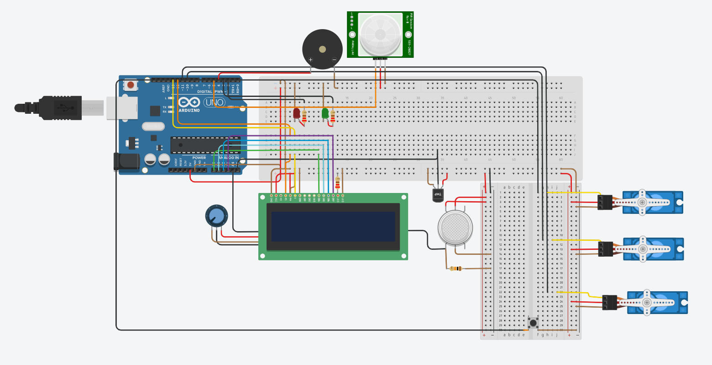
WIRING WALKTHROUGH · 1 OF 5
The Complete Circuit
OVERVIEW
Arduino Uno as the hub
All sensors, the LCD, buzzer, LEDs, and three servos connect back to the Uno's digital and analog headers.
Power rails
5V and GND are bussed along the top and bottom rails of both breadboards, feeding every component.
PIR + buzzer up top
Mounted above the breadboard for a clean, unobstructed sensing field.
Sensors on the right
The MQ2 gas element and TMP36 sit beside the three servos (door, window, sprinkler).
REELESH GANESH BHOYRUB | COHORT IoT 7
11

Slide 13
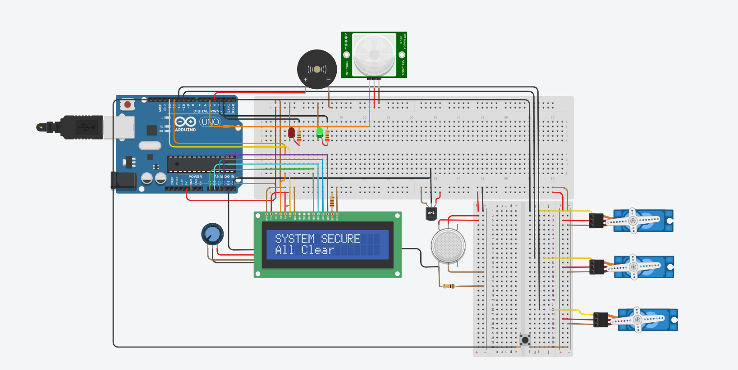
WIRING WALKTHROUGH · 2 OF 5
Safe Mode — All Clear
SAFE MODE
Default resting state
This is what the circuit shows the moment the sketch boots and no hazard is present.
Green LED lit, red LED off
A simple, instant visual cue that the home is currently secure.
LCD reads SYSTEM SECURE / All Clear
Refreshed only when the message changes, so the display never flickers.
All servos at 0°
Door unlocked, window closed, sprinkler off — the neutral position for every actuator.
REELESH GANESH BHOYRUB | COHORT IoT 7
12

Slide 14
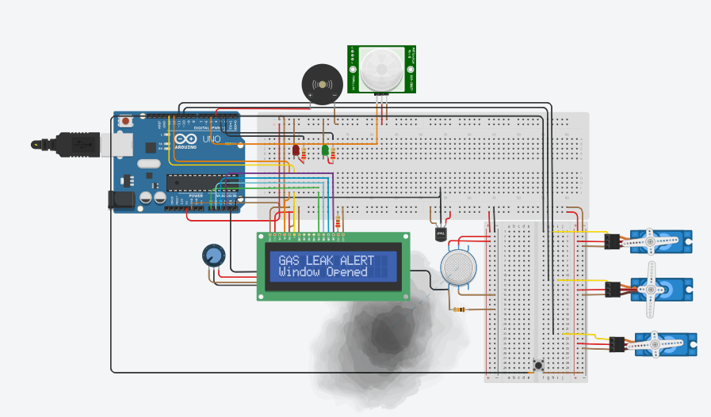
WIRING WALKTHROUGH · 3 OF 5
Gas Leak Response
GAS LEAK
MQ2 crosses the threshold
Once analogRead(A4) exceeds 300, the code calls triggerGasLeak().
Window servo opens to 90°
Servo 2 rotates immediately to represent a window opening for ventilation.
LCD reads GAS LEAK ALERT / Window Opened
Clear, specific feedback — not just a generic alarm.
Buzzer tones at 1500Hz
A distinct pitch from the fire and intruder alerts, so occupants can tell hazards apart by ear.
REELESH GANESH BHOYRUB | COHORT IoT 7
13

Slide 15
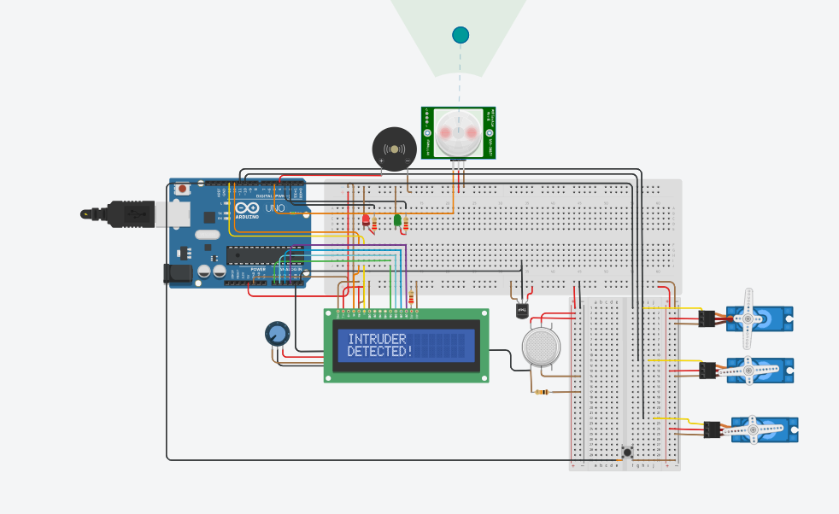
WIRING WALKTHROUGH · 4 OF 5
Intruder Detection
INTRUSION
PIR sensor reads HIGH
Motion within the sensor's field triggers triggerIntruder() on the very next loop.
Door servo locks to 90°
Servo 1 rotates to represent the main door locking automatically.
Red LED on, green LED off
The green 'all clear' indicator is cut the instant a threat is confirmed.
LCD reads INTRUDER DETECTED!
Paired with a 1000Hz buzzer tone to draw immediate attention.
REELESH GANESH BHOYRUB | COHORT IoT 7
14

Slide 16
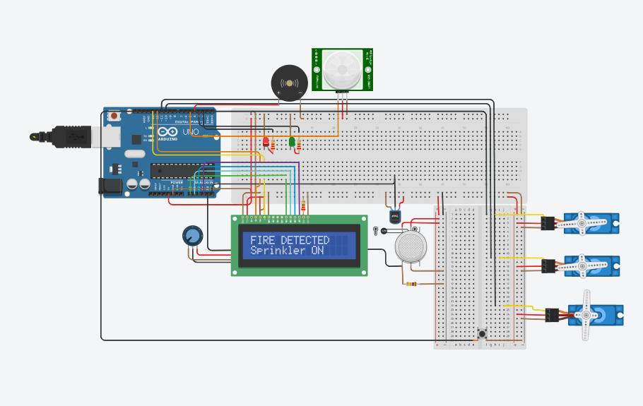
WIRING WALKTHROUGH · 5 OF 5
Fire Detection & Sprinkler
FIRE
TMP36 exceeds 40°C
The highest-priority check in the code — fire always overrides gas and intruder alerts.
Sprinkler servo activates to 90°
Servo 3 represents a water valve opening to begin suppression.
Red LED on + 2000Hz buzzer
The sharpest, most urgent tone of the three alerts.
LCD reads FIRE DETECTED / Sprinkler ON
Confirms both the hazard and the automatic response taken.
REELESH GANESH BHOYRUB | COHORT IoT 7
15

Slide 17
SOFTWARE LOGIC
How the System Prioritizes Hazards
Every ~200 milliseconds, the Arduino reads all three sensors and works through a fixed priority order — because if more than one hazard is happening at once, the most life-threatening one has to win.
1
2
3
4
FIRE
GAS LEAK
INTRUDER
SAFE
Temp > 40°C
MQ2 > threshold
PIR = HIGH
No hazard active
Highest priority checked first → falls through to Safe Mode only when nothing else is active
REELESH GANESH BHOYRUB | COHORT IoT 7
16

Slide 18
WHERE THIS GOES NEXT
From Simulation to Real IoT Deployment
Swapping the Arduino Uno for an ESP32 adds Wi-Fi and Bluetooth — unlocking a genuinely connected version of this system.
1
Mobile Notifications
2
Cloud Event Logging
3
CCTV Activation
Push alerts to the homeowner's phone the instant a hazard is detected.
Every alert timestamped and stored for later review or insurance records.
Trigger a camera feed automatically during an intrusion event.
4
Live Remote Monitoring
5
Remote Arm / Disarm
6
Real-Time Dashboard
Check sensor status and camera feeds from anywhere with internet access.
Turn the system on or off from a mobile app, no physical access needed.
A live web view of every sensor reading, not just the current LCD message.
REELESH GANESH BHOYRUB | COHORT IoT 7
17

Slide 19
CONCLUSION
Small Circuit, Real-World Stakes
This project shows that the same sensing-and-response principle behind proven, life-saving technology — working smoke alarms, monitored gas detectors, and visible security systems — can be built, tested, and understood on a student budget. The Arduino doesn't just detect a hazard; it acts on it immediately, closing the gap between alarm and response that costs lives in the real world.
PROJECT AT A GLANCE
3 hazards monitored
6 sensors & actuators
3 automated servo responses
60%
lower fire death risk with a working alarm
1 unified LCD status display
83%
of burglars avoid homes with visible alarms
1-button manual reset
400+
annual U.S. CO deaths a gas sensor can help prevent
REELESH GANESH BHOYRUB | COHORT IoT 7
18

Slide 20
Thank You
Questions & Discussion
Reelesh Ganesh Bhoyrub
Cohort IoT 7 • IoT-Based Home Security and Surveillance System

